Slide 1






PUBLIC LECTURE
ON
FINANCIAL LITERACY
BY
KENNETH S. MATOMOLA
CHIEF EXECUTIVE OFFICER

Slide 2


CONTENT
01
02
03
04
05
About NAMFISA
Financial Literacy
Digital Finance
Money
Risk and Rewards
07
08
09
06
10
Personal Finances
Debt
Retirement
Personal Estate
Recourse Mechanism

Slide 3
ABOUT NAMFISA

Slide 4



NAMFISA AS PE
NAMFISA was established by an Act of Parliament - NAMFISA Act, 2001 (No.3 of 2001)
MANDATE
Supervision
Advisory
Enforcement of Financial Intelligence Act, 2012

Slide 5




VISION AND MISSION
To have a safe, stable and fair financial system contributing to the economic development of Namibia in which consumers are protected.
BORCELL
To regulate and supervise financial institutions and financial intermediaries to foster a stable, fair non-banking financial sector, to promote consumer protection and provide sound advice to the Minister of Finance.

Slide 6
SUPERVISORY SCOPE
Regulated financial institution or intermediary, by subsector | Number of entities per subsector, 31 December 2021 | Number of entities per subsector, 31 December 2022
Total active pension funds | 83 | 85
Active medical aid funds | 8 | 8
Active friendly societies | 1 | 1
Long-term insurance companies (intermediaries) | 14 (8,634) | 14 (9,540)
Short-term insurance companies (intermediaries) | 14 (2,210) | 14 (2,462)
Special purpose vehicles | 21 | 20
Unit trust management companies | 19 | 19
Investment managers | 31 | 31
Unlisted investment managers | 29 | 30
Microlenders | 360 | 417
Reinsurers for long- and short-term insurance | 1 | 1
Stock exchanges | 1 | 1
Linked investment services providers | 4 | 4
Stockbrokers, including sponsors | 4 | 4
Total (intermediaries) | 590 (10,844) | 649 (12,002)
12 651
regulated entities
NAMFISA regulates 649 financial institutions and 12 002 financial intermediaries
366,2 billion
value of total assets of non-bank financial institutions regulated by NAMFISA.

Slide 7
FINANCIAL LITERACY

Slide 8



Financial Literacy Defined
a
b
c
d
e
make effective decisions across a range of financial contexts
improve the financial well-being of individuals and society
Knowledge and understanding of financial concepts and risks
.
the skills and attitudes to apply such knowledge and understanding
.
enable participation in economic life

Slide 9




Financial Literacy Defined
a
iii) risks that may threaten their financial well-being i.e., digital and traditional products
i) the purpose and basic features of financial products
Knowledge and understanding of financial concepts and risks
.
ii) concepts such as interest, inflation, and value for money
v) Products intended to mitigate certain risks i.e., insurance and pension funds
01

Slide 10


Financial Literacy Defined
b
i) basic skills in mathematical literacy i.e., ability to calculate a percentage, convert from one currency to another
iii) the motivation to seek information and advice financial products and services providers
the skills and attitudes to apply such knowledge and understanding
.
ii) language skills i.e., capacity to read and interpret advertisements and basic contractual texts
iv) the ability to exercise self-control and manage other factors that influence financial decision making

Slide 11

Financial Literacy Defined
i) informed and responsible decisions that satisfy a given need
c
ii) financial contexts that relate to daily life and experience i.e., use of pocket money, schooling, wedding etc.
make effective decisions across a range of financial contexts

Slide 12

Financial Literacy Defined
i) way individuals understand, manage and plan their own and their households’ – which often means their families’ – financial affairs
d
improve the financial well-being of individuals and society
ii) collective impact on the wider society, in contributing to local prosperity as well as national and even global stability, productivity, sustainability and development

Slide 13



Financial Literacy Defined
e
enable participation in economic life
i) equips individuals to make decisions that are of benefit to themselves and their family or community
ii) to constructively support and critique the economic world an individual lives
Strategy nº 1
Strategy nº 2
Strategy nº 3

Slide 14





Rationale of Financial Literacy
  Widespread emergence of digital financial products and services
  Cyber risk
  Financial crimes i.e. money laundering, financing of terrorism, market abuse and insider trading, etc.
Financial literacy is globally acknowledged as an essential life skill.
It is an important element of economic and financial stability and development
.
Evolving financial sector

Slide 15



STATISTICS

Slide 16
STATISTICS – NAMIBIA’S RANKING
Literacy is the ability to ready and write

Slide 17
MONEY

Slide 18



MONEY
Understanding the functions, characteristics, and types of money helps us navigate the complex world of finance
Serves as
Medium of exchange
Unit of account
Store of value
Facilitates Economic Transactions

Slide 19
DIGITAL FINANCE
Digital financial services comprises a broad range of financial services accessed and delivered through digital channels (including mobile financial services), including payments, credit, savings, remittances and insurance.

Slide 20



Digital Products and Service
Digital Products and Services vs Young People
Great possibilities for integrating into the formal financial system
No physical barriers, lower costs, faster and timely transactions
Not without risks, e.g.,
-fraud
-security and confidentiality of data
Young people are more likely to be victims of online fraud, although they are digital natives through social media
Identity theft, fraudulent investment schemes

Slide 21


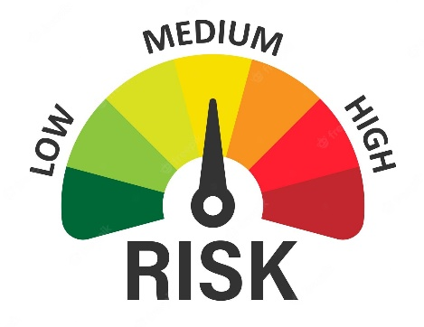

RISKS AND REWARDS
Risk and reward is knowing that there is a high chance of making money on savings or investment, and there is also a high likelihood of losing money.
Identifying risks that may occur and most likely to have a serious negative effect on a particular person
Managing risks and rewards associated with life events or the economy, i.e. - Accident or injury
- Natural catastrophes
- Job loss
- Market fluctuation
Recognizing that certain financial products can be used to manage and offset various risks

Slide 22
PERSONAL FINANCE
Ii is the process of planning and managing personal financial activities such as income generation, spending, saving, investing, and protection.

Slide 23





INCOME
Source of cash flow that an individual receives
F
I
N
A
N
C
E
SPENDING
Expenses that a person incurs in return to the purchase of goods and services or anything that is consumable
SAVING
Refers to excess cash that is retained for future investing or spending, i.e., bank account - short-term nature
INVESTING
Purchase of assets that are expected to generate a rate of income, i.e. listed shares, properties, live stock, unit trusts – long term in nature
Refers to a wide range of products that can be used to guard against an unforeseen and adverse event, i.e. insurance products
PROTECTION

Slide 24


MANAGE PERSONAL FINANCES
SOME GUIDELINES:
01
02
03
04
Save and invest
Manage debt wisely
Avoid compulsive spending
Review and adjust regularly
Seek financial education
Protect yourself with insurance
Create a budget
Track your expenses

Slide 25

Stick to your budget
PERSONAL FINANCE: BUDGETING
STEPS TO CONSIDER WHEN BUDGETING:
STEP 1
STEP 2
STEP 3
  List all your sources of income and all the expenses
  Decide how much you want to save before spending
  Stick to your budget
Notes:
The Consumer Credit Regulators are Bank of Namibia for the banks, and NAMFISA for all the others.

Slide 26


SAVINGS
START NOW!!
Spend responsibly
Set savings goals
Create budget
WHAT MATTERS IS A SAVINGS HABIT; NOT HOW MUCH YOU SAVE

Slide 27



SAVINGS & INVESTMENT
“The higher the risk, the higher the return”
01
02
Every savings and investment carry certain degree of risk
Risk is determined by the type of investment or savings vehicle and the financial institution’s credibility
03
04
Savings are short-term in nature, normally have a lesser risk and hence lower returns
Investments are long-term in nature thus risk is elevated

Slide 28



TIPS ON INVESTMENT
Objective n° 1
Diversified Portfolio
Education and Personal Development
  Stocks/Shares
  Bonds
  Mutual Funds and Exchange-Traded Funds (ETFs)
  Real Estate
  Index Funds
  Properties
  Livestock
Objective n° 3
Consult a Financial Advisor

Slide 29
DEBT

Slide 30


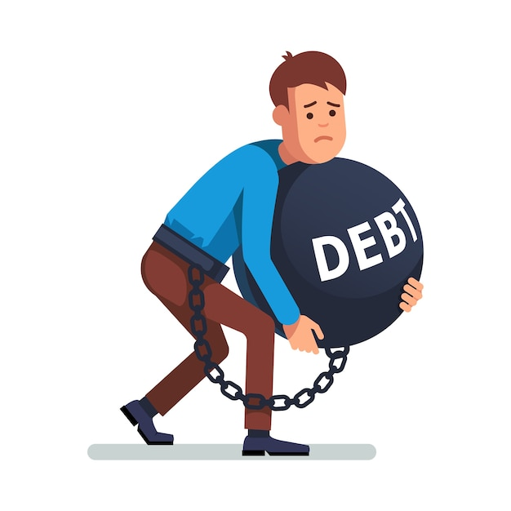
DEBT CONSIDERATION
  Before Borrowing
  Over-Indebtedness
  Manage Debt
Needs analysis
Is it the best option, i.e.
  shop around
  keep repayment period short
  Hidden costs
Affordability
Registered institution
Other financial worries
Stress
Bad credit record
Seizure of assets
Depression
Understand terms and conditions
Prioritize repayment
Avoid excessive borrowing
Stick to your budget
Reduce unnecessary expense
Stay within budget

Slide 31
RETIREMENT

Slide 32


RETIREMENT FUND
Retirement Fund (Scheme) is a savings plan to help an individual to save money for later life
Rationale For Retirement Funds
People living longer (live expectancy increase)
Expenses to cater for in old age
Depending on children decreasing
Benefiting from tax reliefs
Provide protection in the form of lump sums and annuities

Slide 33

PREPARE FOR RETIREMENT
Set retirement goals
Estimate retirement expenses
Assess your current financial situation
01
Create a retirement savings plan
Diversify your investments
Manage debt
02
Plan for healthcare costs
Review and update your plan regularly
Educate yourself and seek professional advice
Focus on financial education
03

Slide 34
PERSONAL ESTATE

Slide 35


PERSONAL ESTATE
Assets and belongings that an individual owns or possess.
Personal estate includes various types of property, possessions, investments, livestock, financial accounts owned by an individual during their lifetime

Slide 36
Personal Estate
Planning for one's personal estate involves: -
- creating a will,
- considering estate taxes, and
- ensuring the smooth transfer of assets to beneficiaries.
.
Essential to review and update estate plans regularly to reflect changing financial circumstances and family dynamics

Slide 37
RECOURSE MECHANISM

Slide 38


Slide 39

Consumer Protection
NAMFISA has an implied mandate to foster consumer protection, which includes:
  Consumer recourse mechanism – consumer of non-banking financial services and product can lodge complaints
  Consumer education – empowering the public to understand financial services and products.
Financial institutions and Regulatory Authorities have dedicated channels to handle complaints

Slide 40
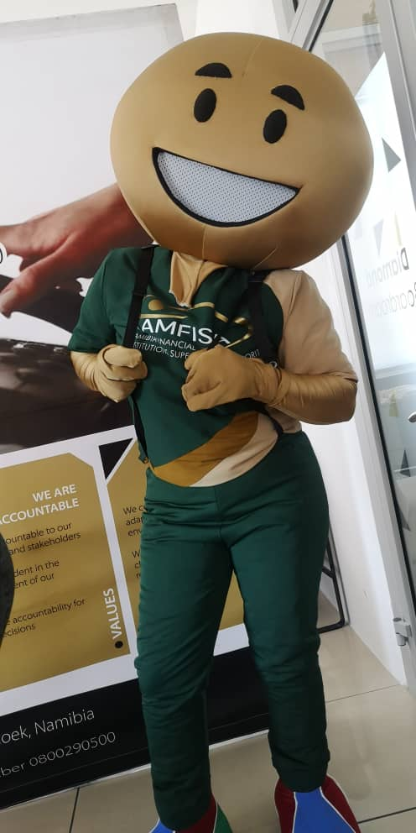





HOW TO LODGE A COMPLAINT WITH NAMFISA
      In person (51 -55 Werner List Street, Gutenberg Plaza, Lower Ground Floor)
      Telephonically 061-290 5134/0800 290 5000
      (Office Hours)
      Toll-Free Number 0800 290 500
      By letter/statement or complaints form which can be:
      Faxed 061- 290 5161
      Posted (P O Box 21250, WHK)
      Online: www.namfisa.com.na
      complaintsdept@namfisa.com.na

Slide 41


PERSONAL FINANCE MANAGEMENT FINAL WORD
Everest Cantu
Tim Pawlenty
Remy Marsh
Ceo Of Ingoude Company
President and CEO, Financial Services Roundtable
Ceo Of Ingoude Company

